Slide 1
Music Generation Using Deep Learning
Topics of Deep Learning
Team
Kokila K N PES2201800625
Rajesh Manchikanti PES2201800570
Arjun Shekhar PES2201800072

Slide 2
Outline
Problem Statement
Literature Review
Flow Diagram
Requirements
Frameworks
Deliverables

Slide 3
Problem Statement
MUSIC GENERATION USING DEEP LEARNING
Everyone like to listen interesting music and if there is some way to generate music automatically, particularly decent quality music then it’s a big leap in the world of music industry.
Music is nothing but a sequence of musical notes,so collection of such sequences of different musical instruments can be helpful to generate music with the help of AI as a human do.

Slide 4
Literature Survey
Paper 1: Music Generation Using Bidirectional Recurrent Network
This paper talks about bidirectional recurrent network,an efficient approach which generates note suitable to global perspective.To generate harmonic ,both positive direction data(previous data) and negative direction data should be considered,but traditional methods use only previous data
to generate current note.
According to author of paper, In BRNN activation of current note is generated based on context,previous activations and next activations,an efficient lose function is used to overcome lot of meaningless results.Quality of music generated is far better than any traditional probabilistic approach and markov models.
BRNN uses LSTM (special case of RNN) because of its capability of storing meaningful information for long short term . Two LSTM are stacked to increase the network capacity
This paper uses 2 bit piano-roll as a input to BRNN

Slide 5
Literature Survey
Paper 2: Generating Music Algorithm with Deep Convolutional Generative Adversarial Networks
This paper proposes an advanced arithmetic for generating music using Generative Adversarial Networks (GAN). The
music is divided into tracks and the note segment of tracks is expressed as a piano-roll, through trained a gan model which generator and discriminator continuous zero-sum game to generate a wonderful music integrallty. In addition to the final output layer, we use the sigmoid activation function to distinguish between
real data and generated data.
Also, the discriminator of the GAN model has been optimized according to the nature of the music data.
Because of the algorithm design of the paper, we are required to convert the prepared midi file into a piano roller blind and then transform it into the input data format that we need to train.After establishing the G-network and D-network models, we then trained the network GAN.
We used two sets of programs to evaluate our experimental results, the first set is based on statistically objective evaluations,while the second set is to conduct a sample survey. Experimental data and user evaluations show that the proposed model can generate music like sequence generation.The model is theoretically mature and has ideal properties.

Slide 6
Literature Survey
Paper 3 : STYLE-CONDITIONED MUSIC GENERATION
This paper talks about generating music automatically based on content and style inputs from user rather than training a single musical data and generating music.
This paper is based on the formulation of VAE (Variational Autoencoder) to generate music , where they have collected dataset from MIDI files (Bach Chorales (JSB) dataset and Nottingham Music Database (NMD)), this music data is converted to non overlapping segments and the data has been encoded with bidirectional hyper LSTM layer an decoded with unidirectional HYperLSTMand the model is built around 500 music sample of each data sample is generated, the number of chords and the unique pictures in the training data is compared against the generated samples and along with music generation style transfer is also done.
This paper presents about the vanilla sequence-to-sequence variational autoencoder that allows user to condition the style of generated output music. This model involves a continuous style embedding for each style in the dataset.

Slide 7
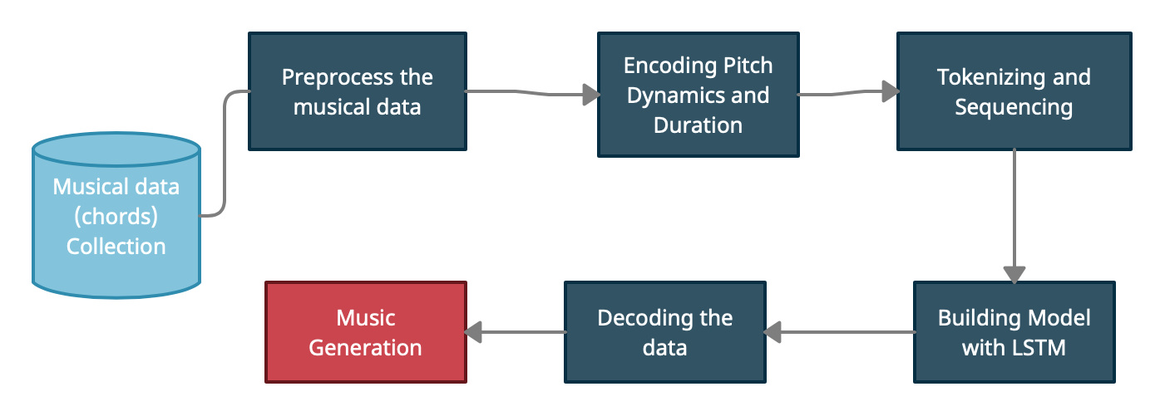
Flow Diagram

Slide 8
Software and Hardware Requirements
Hardware requirements
Processor - 1.9 - 3.3 gigahertz (GHz) or faster 64-bit dual core processor with SSE2 instruction set
Memory - 4GB RAM or more
Software requirements
Operating System
Python
Jupyter Notebook

Slide 9
Framework and Tools
For model
Keras
Tensorflow
Music21
Magenta by tensorflow
Pandas
Numpy
Matplotlib
Scipy
For Website
HTML
CSS
JS
Flask (for API)
For Hosting
AWS/Heroku

Slide 10
Final Deliverables
SRS Document.
Collection of data for model building.
Deep Learning model for music generation.
Functional website which generates a completely new music every time a user access.
IEEE format report.

Slide 11
Music Generation
Data sources:
https://drive.google.com/file/d/0B4wY8oEgAUnjX3NzSUJCNVZHbmc/view
Model Used?
Long short Term Memory is used for generation model to generate music of various instruments
One lstm model is used to for each instruments music present
User can play music of each instrument separately or mix of random 3 instruments or mix of all instruments
Recorded songs are also available for the user

Slide 12
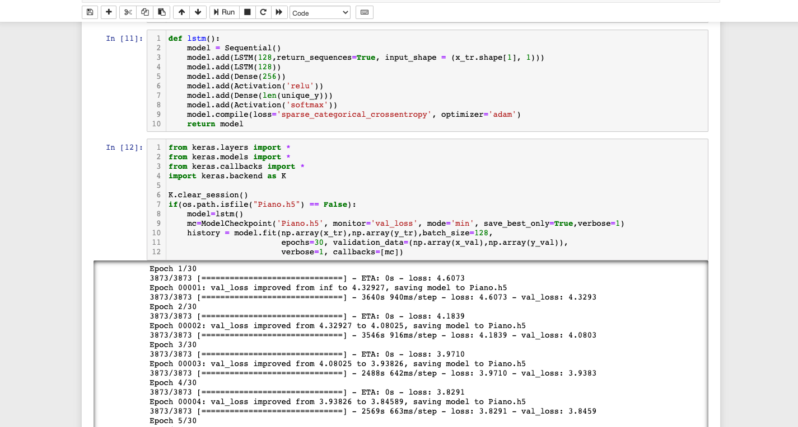
Screenshots

Slide 13
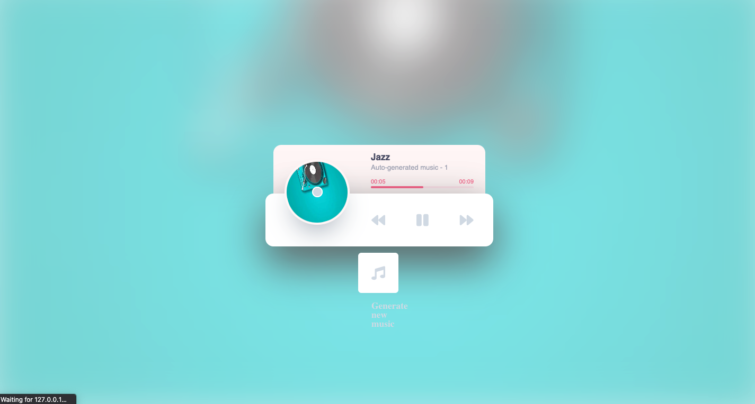
Screenshots

Slide 14
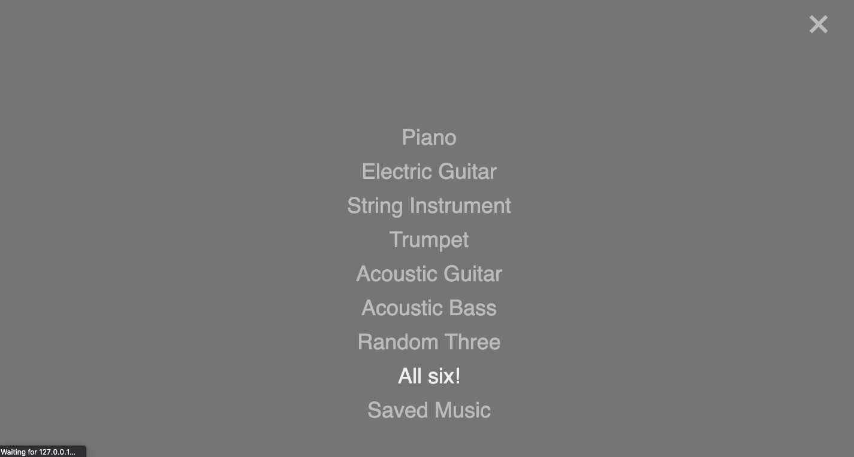
Screenshots

Slide 15
Thank You

